Slide 1
Image from USA Today

Slide 2
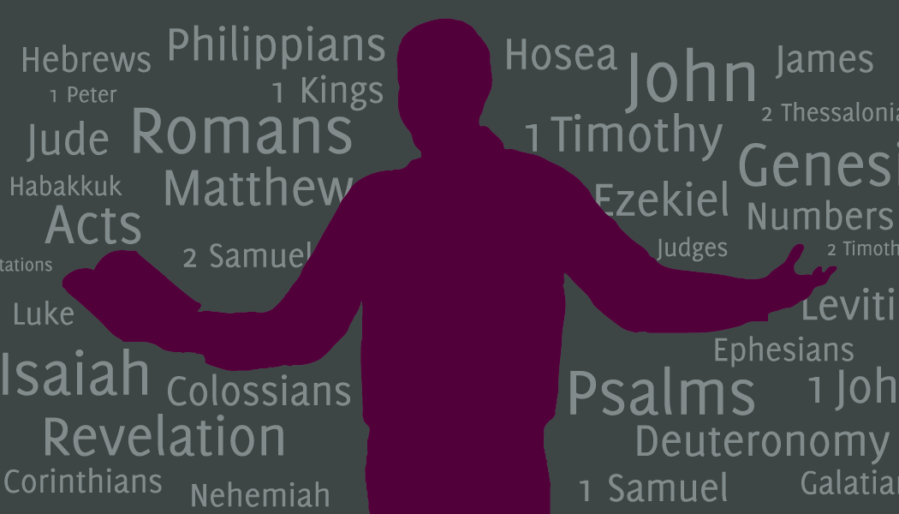
Grace Love Truth

Slide 3
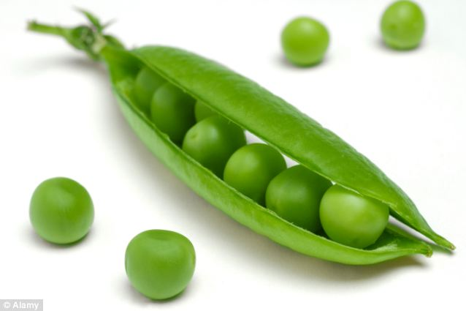
DailyMail.co.uk

Slide 4
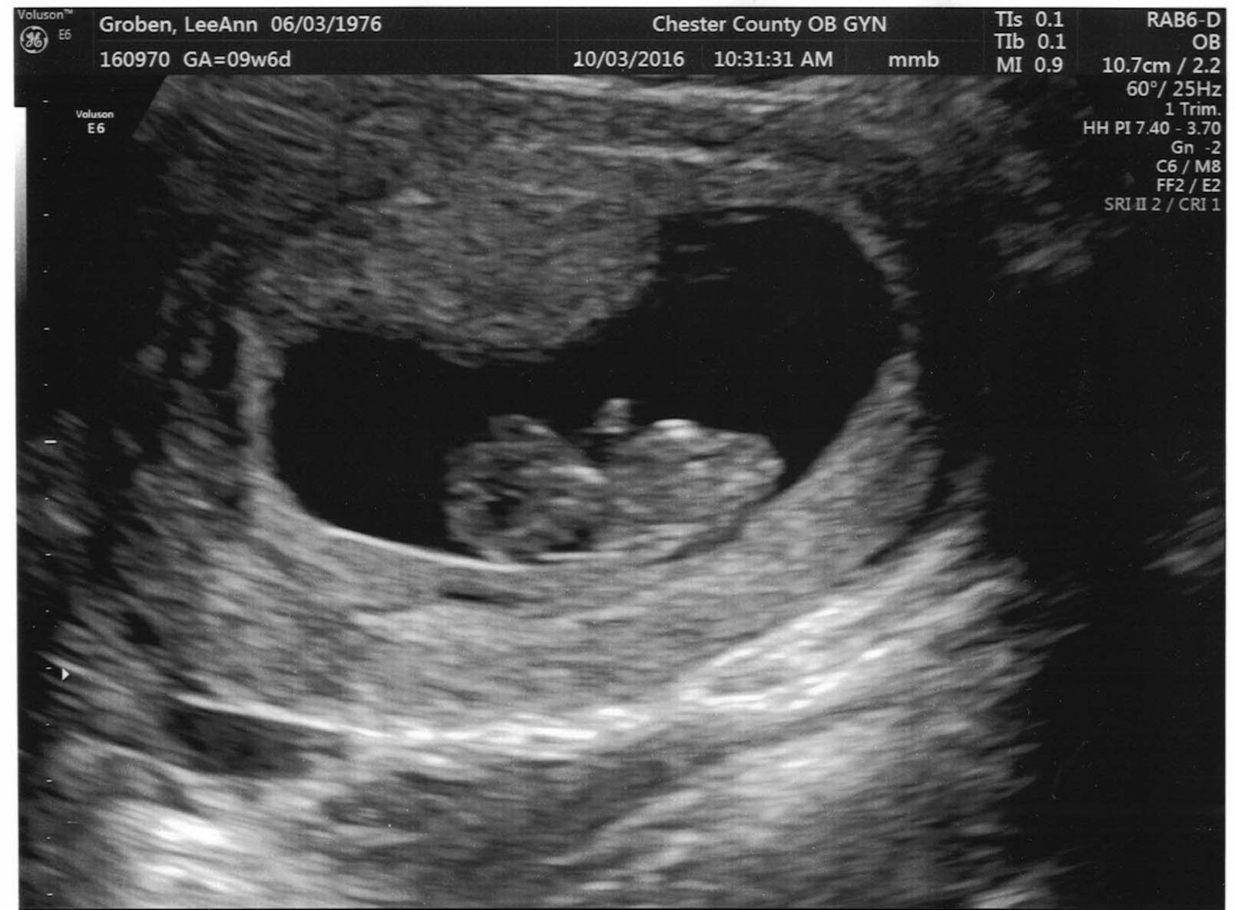

Slide 5
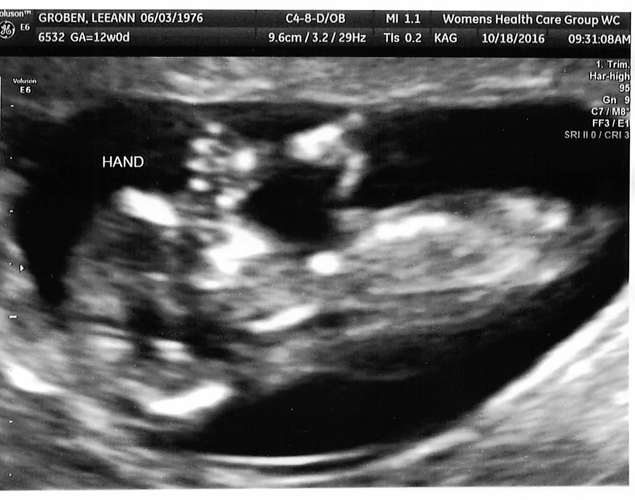
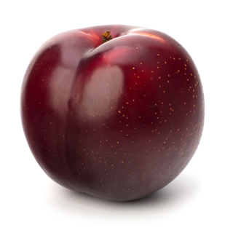
en.unitec-group.com

Slide 6
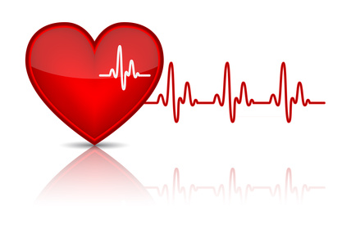
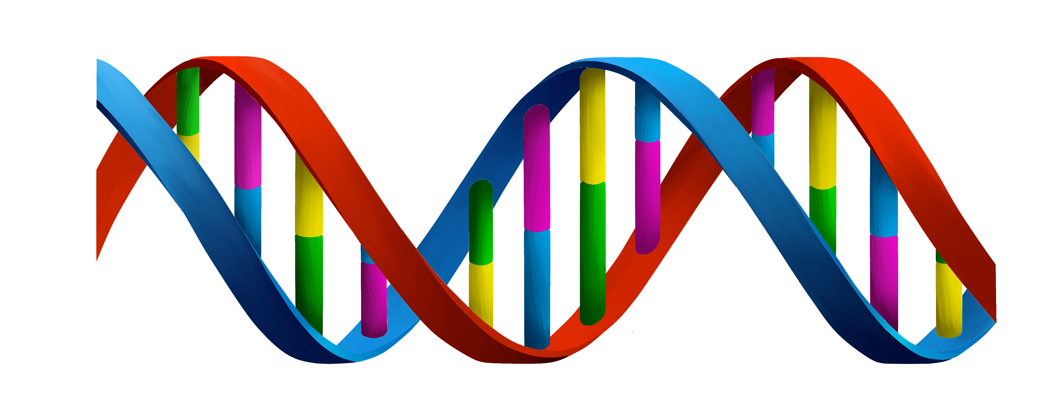
Embryo Fetus Baby
Teespring.com
Icone-png.com

Slide 7
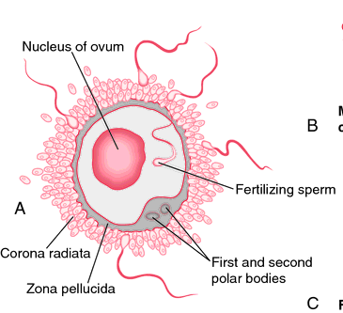
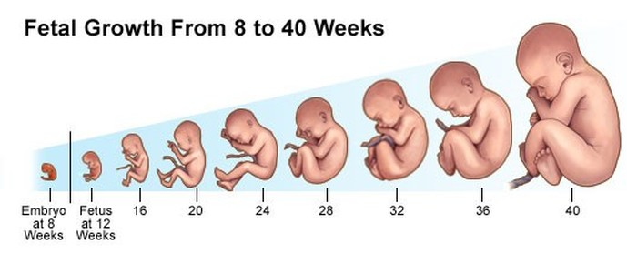
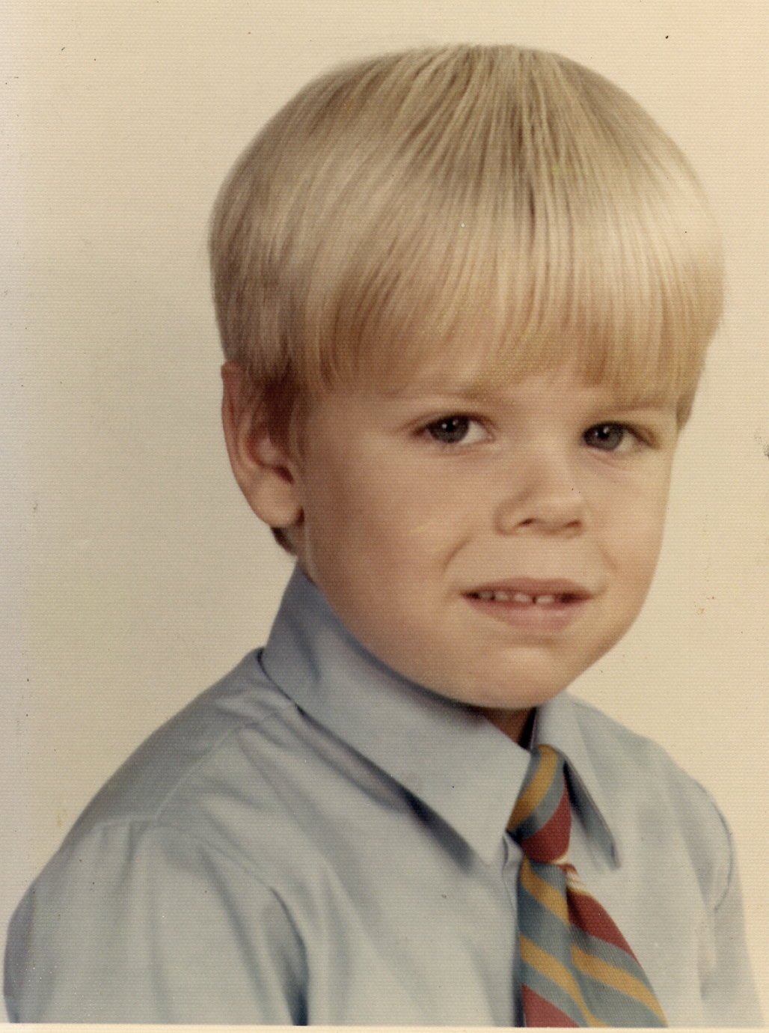
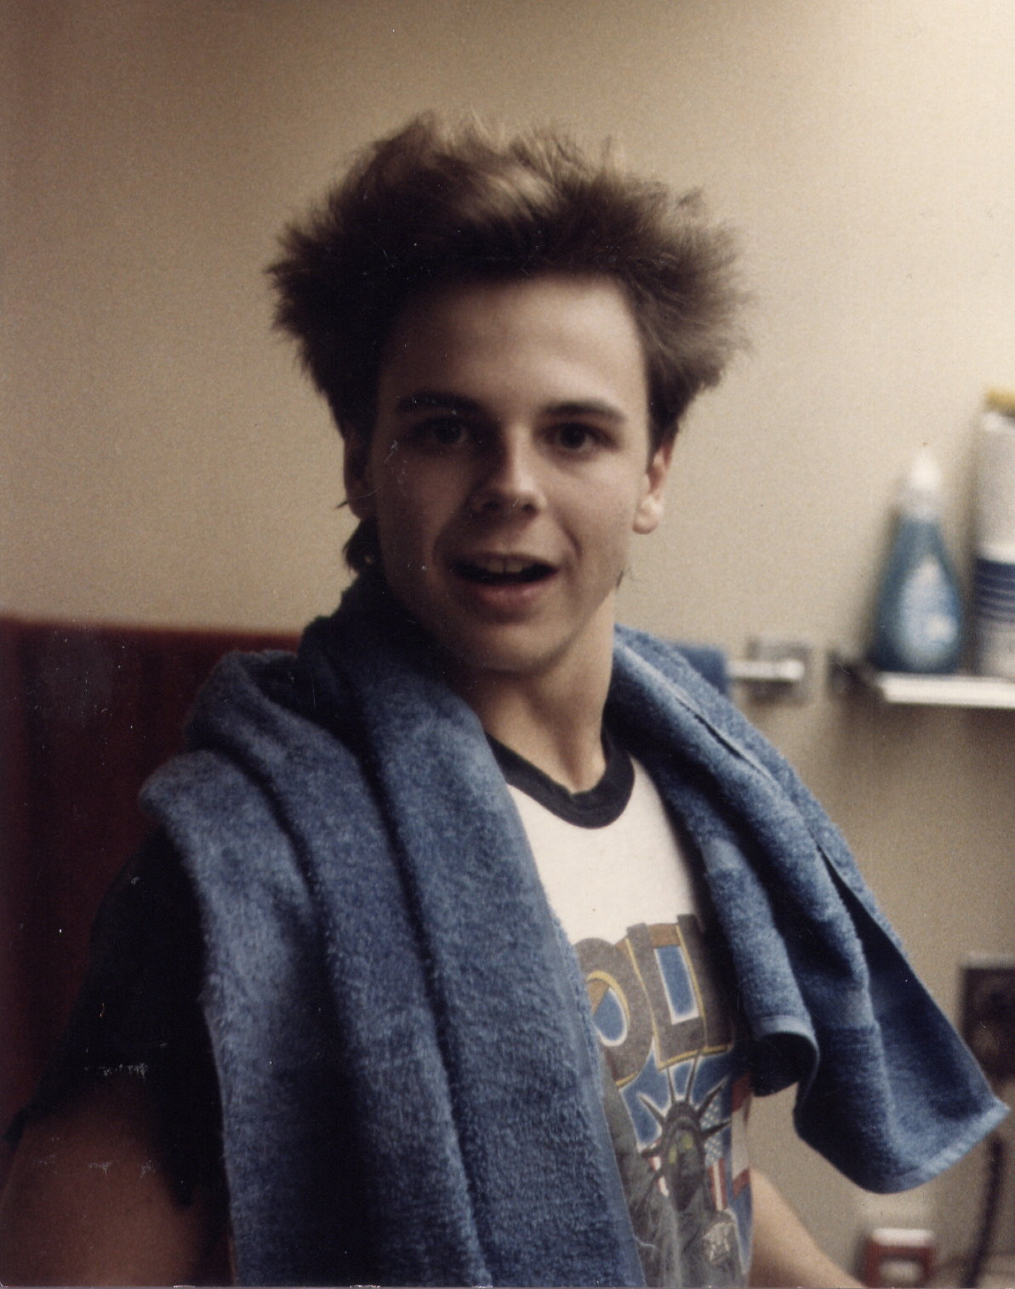
Images from medical-dictionary.thefreedictionary.com; theprolifeyouth.com

Slide 10
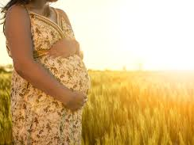
Exodus 21.22-25 NIV: If people are fighting and hit a pregnant woman and she gives birth prematurely but there is no serious injury, the offender must be fined whatever the woman's husband demands and the court allows. But if there is serious injury, you are to take life for life, eye for eye, tooth for tooth, hand for hand, foot for foot, burn for burn, wound for wound, bruise for bruise.
Texasfertilityaccupuncture.com

Slide 11
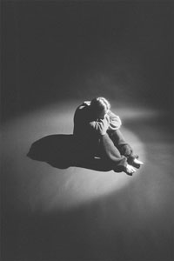
Jeremiah 20.14-18 NIV: Cursed be the day I was born! . . . Why did I ever come out of the womb to see trouble and sorrow and to end my days in shame?
Psalms 58.3-8 NIV: Even from birth the wicked go astray; from the womb they are wayward, spreading lies… May they be like a slug that melts away as it moves along, like a stillborn child that never sees the sun.

Slide 12
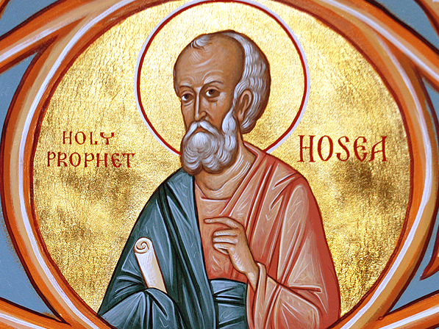
oca.org

Slide 13
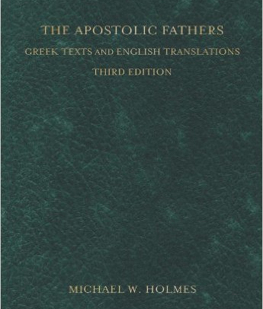
Διδαχὴ 2.2: You shall not abort
a child or commit infanticide.
Amazon.com

Slide 14
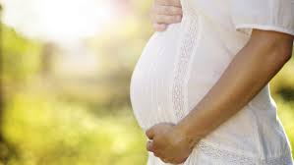
Psalms 139.13-16 NIV: For
you created my inmost being;
you knit me together in my
mother's womb. I praise
you because I am fear-
fully and wonderfully
made; your works are
wonderful, I know that
full well. My frame was
not hidden from you when
I was made in the secret place, when I was woven together in the depths of the earth. Your eyes saw my unformed body; all the days ordained for me were written in your book before one of them came to be.
Pregnancyandbaby.com

Slide 15
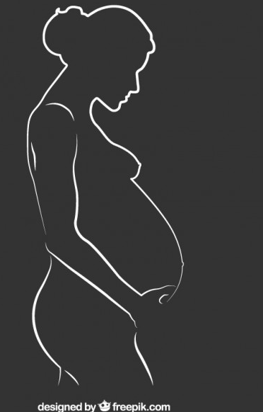
Psalm 51.5-6 NIV: Surely I was sinful at birth, sinful from the time my mother
conceived me. Yet you desired faithfulness even in the womb; you taught me wisdom in that secret place.

Slide 16
Luke 1.39-45 NET: In those days Mary [who was pregnant with Jesus] got up and went hurriedly into the hill country, to a town of Judah, and entered Zechariah's house and greeted Elizabeth [who was pregnant with John]. When Elizabeth heard Mary's greeting, the baby leaped in her womb, and Elizabeth was filled with the Holy Spirit. She exclaimed with a loud voice, “Blessed are you among women, and blessed is the child in your womb! And who am I that the mother of my Lord should come and visit me? For the instant the sound of your greeting reached my ears, the baby in my womb leaped for joy. And blessed is she who believed that what was spoken to her by the Lord would be fulfilled.”

Slide 17
Exodus 20.13 NIV: You shall not murder.
Genesis 1.27-28 NET: God created humankind in his own image, in the image of God he created them, male and female he created them. God blessed them and said to them, “Be fruitful and multiply! Fill the earth and subdue it! Rule over the fish of the sea and the birds of the air and every creature that moves on the ground.”

Slide 18
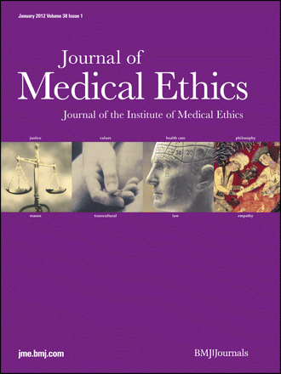

Slide 19
Philippians 2.3-4 NIV:
Do nothing out of selfish ambition or vain conceit. Rather, in humility value others above yourselves, not looking to your own interests but each of you to the interests of the others.
Texasfertilityaccupuncture.com

Slide 20
Grace Love Truth
Image from USA Today

